Slide 2
Todays Agenda
Introduction
Service System
Resolutions and Straw Polls
World Board Motions
Living Clean, FIPT, WCNA
Regional Proposals

Slide 3
Introduction
CAR contents
Service System
Living Clean: The Journey Continues
World Board Motions - FIPT, WCNA
IDTs
Regional Proposals
Addenda

Slide 4
Introduction
Four types of items in this CAR.
For decision at this conference:
Motions – decisions about actions to be taken now
Resolutions – decisions about principles that are binding on future work

Slide 5
Introduction
Four types of items in this CAR.
To gauge support for ideas:
Straw Polls – guide future work; gauge support for specific aspects of the service system proposals
Regional Proposals – ideas from regions for study and consideration

Slide 6
Introduction
Two types of proposals:
Service System Proposal Report (CAR Addendum A) – a background resource to understand the resolutions and the straw polls
Regional Proposals – ideas from regions for study and consideration

Slide 7
Introduction
Why Regional Proposals not Motions:
More flexible than motions
Process of changing motions is complex and intimidating to many
Should allow delegates to bring ideas that can more easily be discussed
This is an experiment.

Slide 8
Service System

Slide 9
Service System
Project Background
Have heard about the same challenges from
Worldwide Workshops
PR roundtables
IDT feedback
Four year project, passed in 2008, renewed in 2010
Proposal report published in August 2010

Slide 10
Service System
This CAR contains:
Third draft proposal report – provided as background. Not to be voted on.
Resolutions
Straw Polls
For more information on the project see: www.na.org/servicesystem

Slide 11
Service System
Resolution 1: Our service efforts will be carried out through a system that includes structure, process, people, and resources.
Resolution 2: The service system is group-focused and includes a local-level body dedicated exclusively to addressing group concerns.

Slide 12
Service System
Resolution 3: Training and mentoring of trusted servants are essential functions of the service system.
Resolution 4: Service bodies are purpose- and vision-driven.

Slide 13
Service System
Resolution 5: Service bodies work together to utilize planning processes to organize and coordinate their efforts.
Resolution 6: Service bodies make decisions by consensus.

Slide 14
Service System
Resolution 7: The service structure includes local service bodies, state/nation/province service bodies, and intermediate bodies if needed. Service bodies follow established geographic boundaries. They are not self-determined, but are formed, based on need, through a collaborative planning process and agreement with other affected service bodies at the next level of service.

Slide 15
Service System
Resolution 8: State/national/province boundaries are the primary criterion for seating consideration at the World Service Conference.

Slide 16
Service System
Straw Polls
There is a small, neighborhood-sized body devoted to group needs. This group forum, which is typically not part of the delegation stream, is informal in nature and operates through conversation not formal decision making.
Groups send a delegate quarterly to a local service planning meeting. One of those quarterly meetings is a general assembly where all interested members are encouraged to attend and input is given to help plan service activities for the cycle.

Slide 17
Service System
Straw Polls
Services are coordinated by a local service board and carried out by members, committees, and project workgroups who report to that board.
Local service bodies follow county, city, or town boundaries, where practical. (They are much larger than the group forums mentioned above and in many cases larger than the current ASCs.)
The boundaries of those local service bodies are agreed to at the state or national level.

Slide 18
Service System
Straw Polls
Planning cycles are synchronized from level to level (local to state to global) as well as across each level.
When service needs cannot be accomplished effectively by local service bodies and state/national/province bodies, an intermediate level of service can be added.

Slide 19
Service System
Straw Polls
Most states, provinces, or countries have one state-, province- or nationwide service body that is responsible for state- or national-level public relations and coordinating efforts such as training across local service bodies.
Zonal boundaries are decided through a collaborative process with neighboring NA communities, other zones, and the WSC.

Slide 20
World Board Motions

Slide 21
Living Clean: The Journey Continues
Tried to engage the fellowship early in the process
Used tools like workshop outlines, discussion board, survey
Chapter summaries are in CAR essay. Topics ranging from relationships to responsibilities to spirituality.

Slide 22
Living Clean: The Journey Continues
Motion 1: To approve the book Living Clean: The Journey Continues contained in Addendum B.

Slide 23
FIPT
The purpose of the Fellowship Intellectual Property Trust is to lay out the collective decisions the Narcotics Anonymous Fellowship has made over the years concerning its literature and logos. . . . In this one comprehensive document appear the policies our entire fellowship has created to preserve the integrity of its published message and the accountability of its publishing services. (from the FIPT Readers Notes)

Slide 24
FIPT
Note: Motions 2-4 all seek to add language to the same article & section of the FIPT (among other changes). If more than one of the motions pass, therefore, the exact changes to the paragraphs involved may differ slightly from what is shown in the “Policy Affected.”

Slide 25
FIPT
Motion 2: To allow the World Board to make non-substantive corrections to Fellowship-approved literature which do not impact the original meaning of the Fellowship-approved text and which fix typographical errors, obsolete references, references to outdated literature, and other similar corrections. The World Board will announce such corrections in advance of publication.

Slide 26
FIPT
Motion 3: To allow the World Board to bundle, excerpt, and repackage Fellowship-approved literature without changes to the texts themselves. The World Board will announce these actions in advance of publication.

Slide 27
FIPT
Motion 4: To allow the World Board the ability to create and approve enhanced electronic or digital versions of texts that include supplemental materials or connections to other NA materials. The World Board will announce such enhancements in advance of publication.

Slide 28
WCNA
Recent trend of financial loss
Last 10 conventions – profit of over $358,000
Last 5 conventions – loss of over $10,000
WCNA 32 – loss $596,000
WCNA 33 – loss $212,895
WCNA 34 – profit of $282,577*
*could change based on missed room block negotiations

Slide 29
WCNA
WCNA attendance has decreased
WCNA is awkwardly sized
1000 other US fellowship events annually
WCNA 34 registration lower than WCNA 30 in San Diego 8 years ago
WCNA requires a tremendous amount of NAWS resources

Slide 30
WCNA
Motion 5: To hold the World Convention of NA every three years, beginning 2018, alternating North American and non-North American locations, as follows and contained in the revised World Convention Map contained in Addendum C.
YEAR | LOCATION
2018 | North America
2021 | Asia/Middle East/Africa
2024 | North America
2027 | Europe
2030 | North America
2033 | Central and South America

Slide 31
Issues for Discussion
The CAR always also contains issues to discuss on a local level some of which may be discussed at the conference. This CAR has
A brief section on the 2010-2012 IDTs (pg. 30) and
An explanation about the board’s decision to remove .pdfs of full-length books from na.org (pg. 21-22)

Slide 32
Regional Proposals

Slide 33
Regional Proposals
WSC is becoming more discussion based
Motions are discussed before formal business sessions
Communications outside WSC help build consensus
WSC 2012 is an experiment
Covers regional motions in CAR and new business

Slide 34
Regional Proposals
Proposals will be discussed and possibly refined
Proposals may be weighted
Ideas with support could become part of planning process
Next steps will be determined at WSC
CAR and CAT process will be used for policy changes
WSC 2012 is the first step in the process
Notes:
I added this slide to support the text of the outline

Slide 35
Regional Proposals
Proposal A: Carolina Region: For the Fellowship of NA and the WSC to consider a proposal for the creation of Written Service Material dedicated to assisting the members of NA as a whole on (1) how to actively participate in literature and publication projects as well as (2) to have resource material available in providing guidance for the development of Literature and Publication processes locally.

Slide 36
Regional Proposals
Proposal B: Hawaii Region: To produce a book-length publication called 'The NA WAY: Celebration Edition' comprised of a compilation of articles published in the NA WAY 1982-2012.
Proposal C: Tejas Bluebonnet Region: For Board Approved Literature be clearly marked on front “Service Related Material” and not intended to be read during recovery meetings.

Slide 37
Regional Proposals
Proposal D: South Brazil Region: That members who wish to receive the NA Way Magazine in hard copy format pay a subscription fee to cover the costs of printing and mailing.
Proposal E: Upper Midwest Region: Our idea is to revisit the discussion of the world board members no longer having voting status at the world service conference.

Slide 39
2012-2014 Strategic Plan

Slide 40
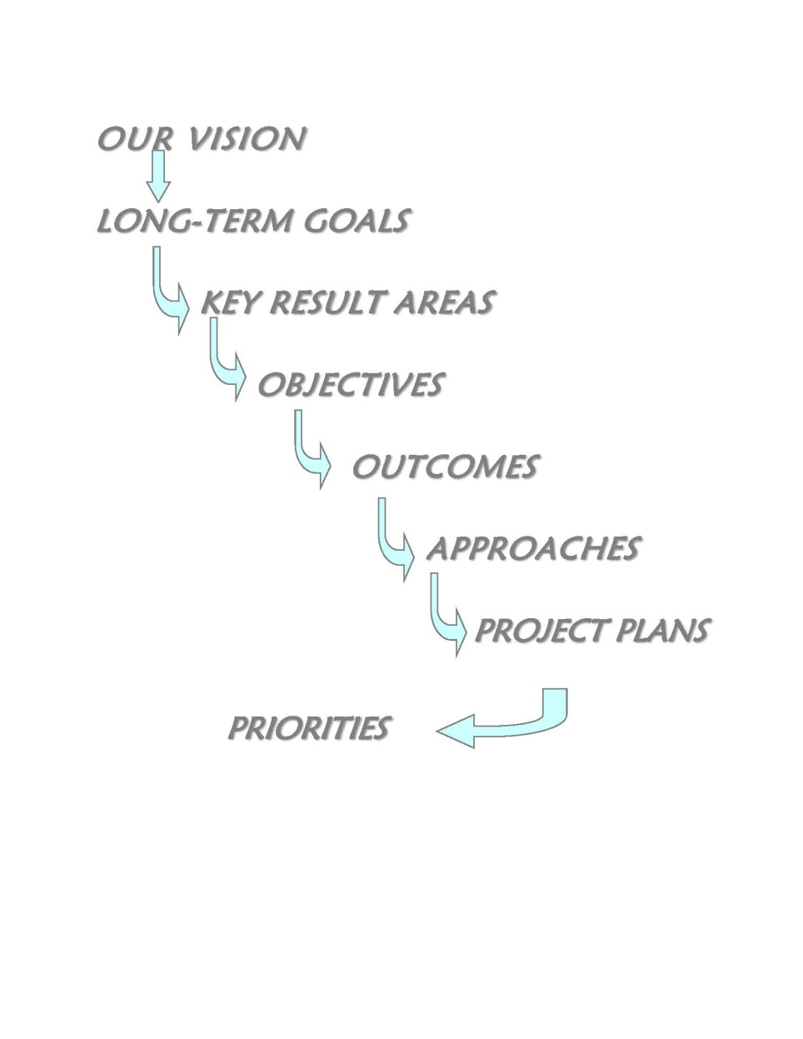
2012-2014 Strategic Plan

Slide 41
2012-2014 Strategic Plan
Key Result Areas:
Internal Communication
External Communication
Fellowship Support
Recovery Literature
Trusted Servant Support and Development
Resources

Slide 42
2012-2014 NAWS Budget
Budget Format:
Operating income:
Gross sales minus cost of goods
Four expense areas:
Literature production and distribution
WSC support
Fellowship development
Events

Slide 43
2012-2014 NAWS Budget
Expense Classifications:
Fixed operational funds:
Recurring “essential services”
Variable operational funds:
Variable expenses – e.g. projects
Reserve funds:
Set aside for future and/or current needs

Slide 44
2012-2014 Project Plans and Estimated Costs/Priority
Fellowship Issue Discussions - $25,000/Essential or Carryover
Service System - $100,000/Essential or Carryover
Traditions Book - $50,000/Priority
Public Relations - $37,000/Priority
An Introduction to NA Meetings - $0/Priority
Trusted Servant Support and Development - $20,000/Secondary

Slide 45
WSC Seating
WSC 2008 – moratorium passed on seating regions resulting from regional splits
WSC 2010 – motion to amend moratorium suspending all seating at WSC 2012 narrowly fails
Moratorium remains in place for WSC 2012

Slide 46
WSC Seating
Seating discussions are in transitional phase
WSC is divided on seating issue
Board believes we should finish discussions about moratorium and future of seating before bringing any new regions to WSC
Siberia/Far East Region may benefit future conferences

